Slide 1

QuickChat: Powered by Power Platform and Microsoft Teams
Amber Weise,
Power Platform Global Black Belt @ Microsoft

Slide 2
“I wish there was an app for that”
We've all been there - you're on an external-facing call with members of your team and you want to ask your teammates:
"How am I doing on time?"
"Is my pitch landing?"
"Who wants to take that as a follow-up item?"
Notes:
If you’ve ever created an internal chat – often called a back-channel/backstage chat – for a meeting, you know that it’s a manual process that is time-consuming and error prone.

Slide 3
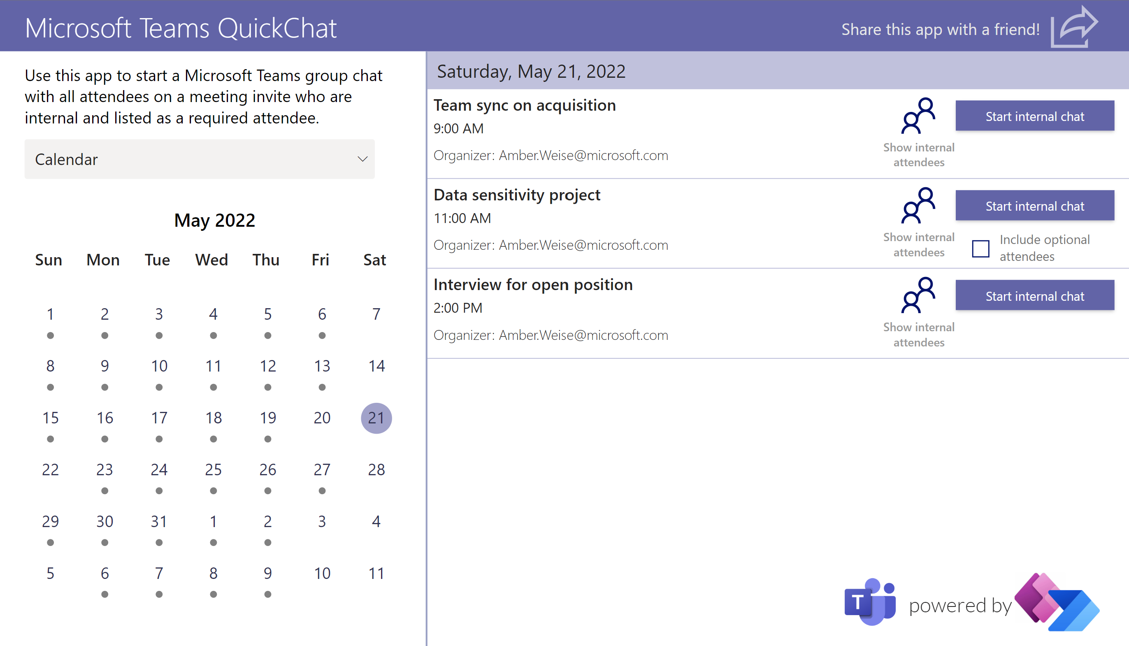
What is QuickChat?
QuickChat, built using Power Apps, allows you to quickly create internal group chats.
Simply click on the associated meeting in the app and a Power Automate workflow will grab all attendees, filter out any external participants, and create a Teams group chat.

Slide 4
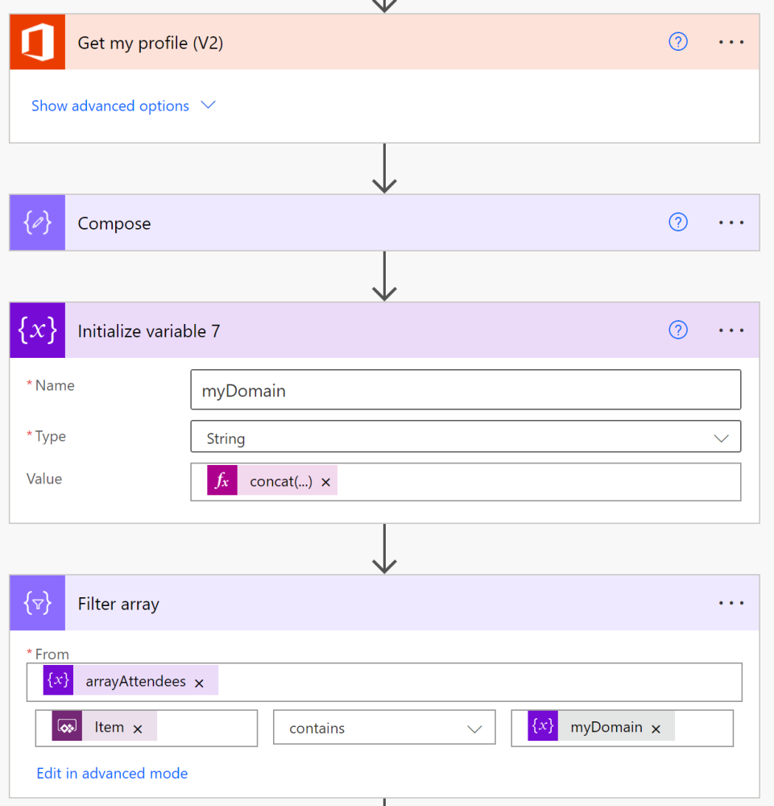
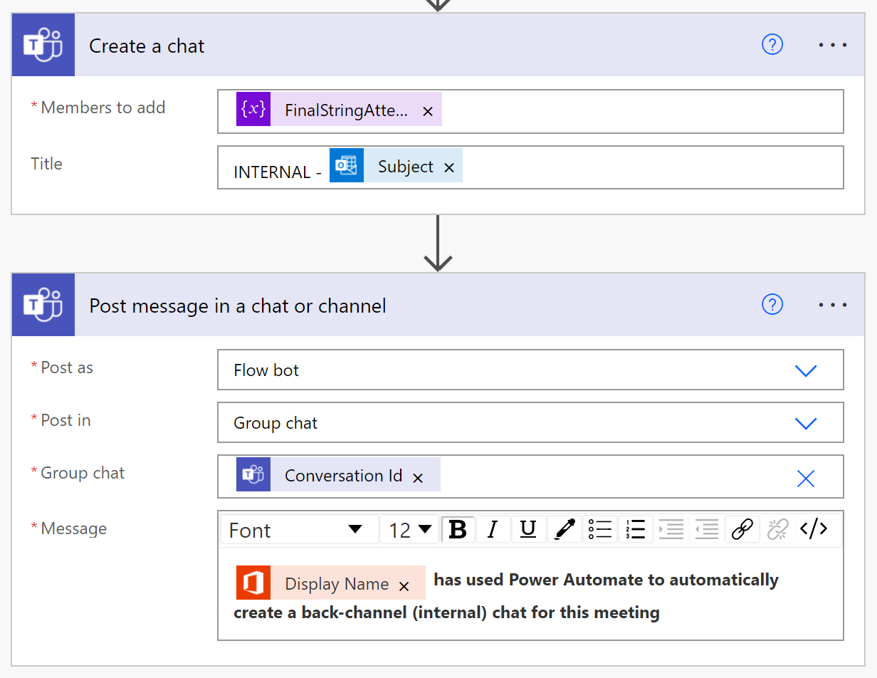
How it works
A Power Automate workflow is then kicked off, grabbing attendees for that meeting and then filtering out any individual whose domain (the "@company.com" part of your email) does not match your own domain.
A Teams group chat is then created with all internal, required attendees and is named "INTERNAL - <Meeting Name>".

Slide 5
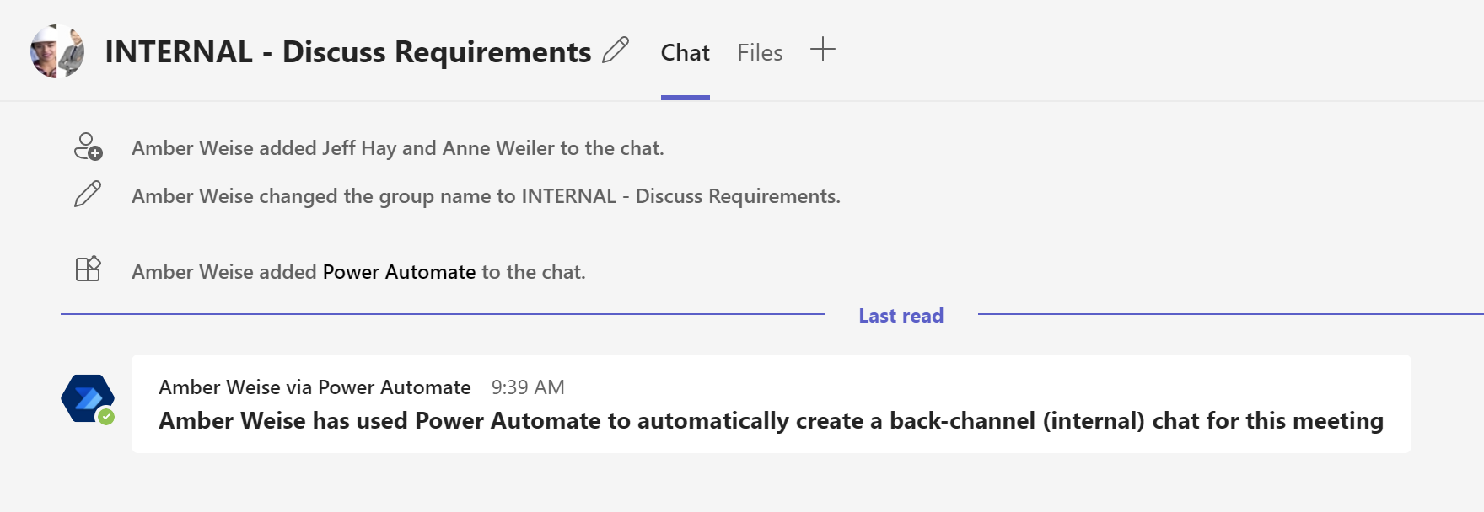
How it works
Lastly, the first chat message is sent by the Power Automate bot informing individuals that the chat was created.

Slide 6
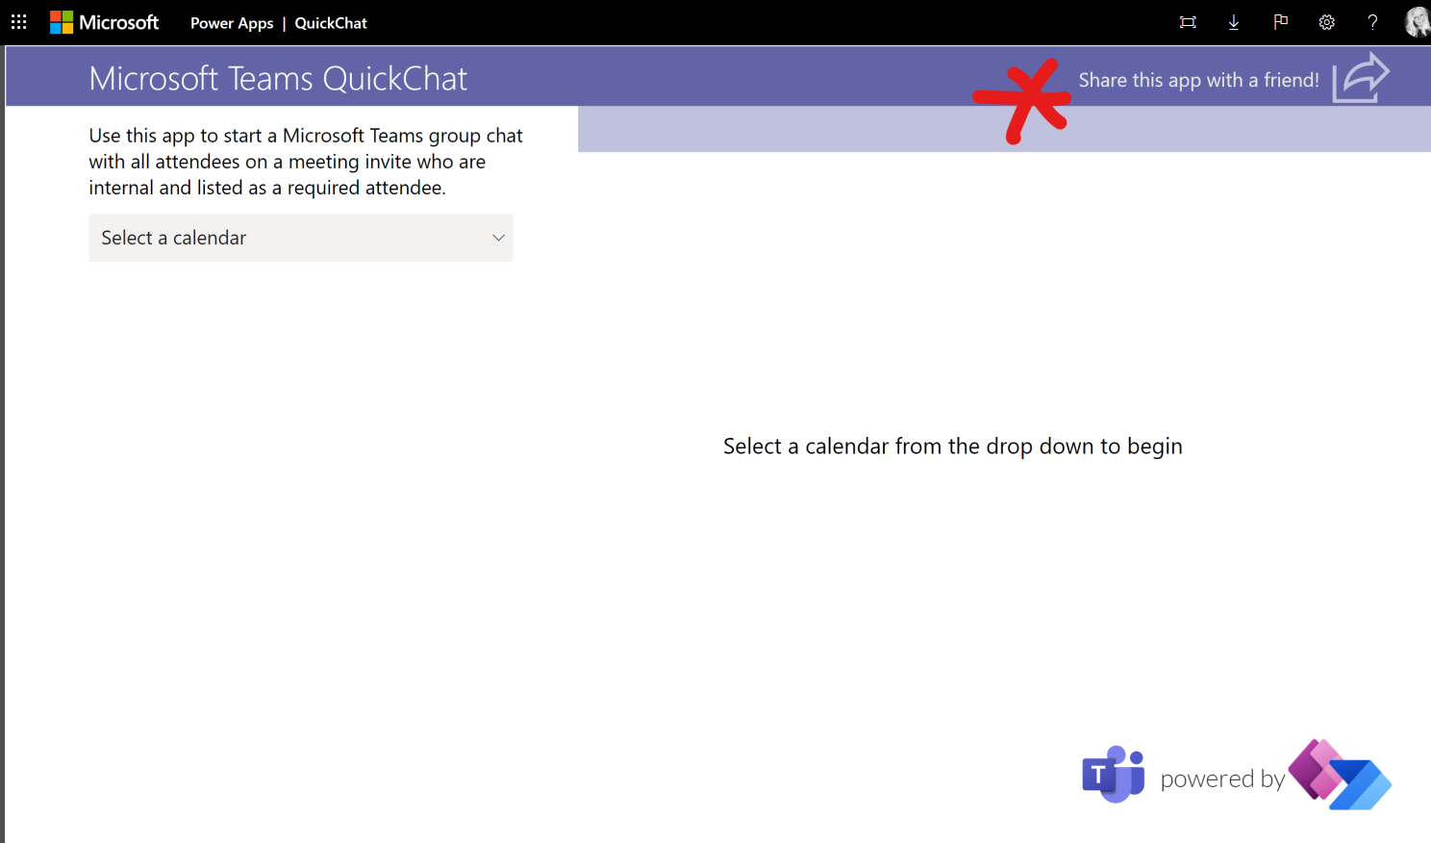
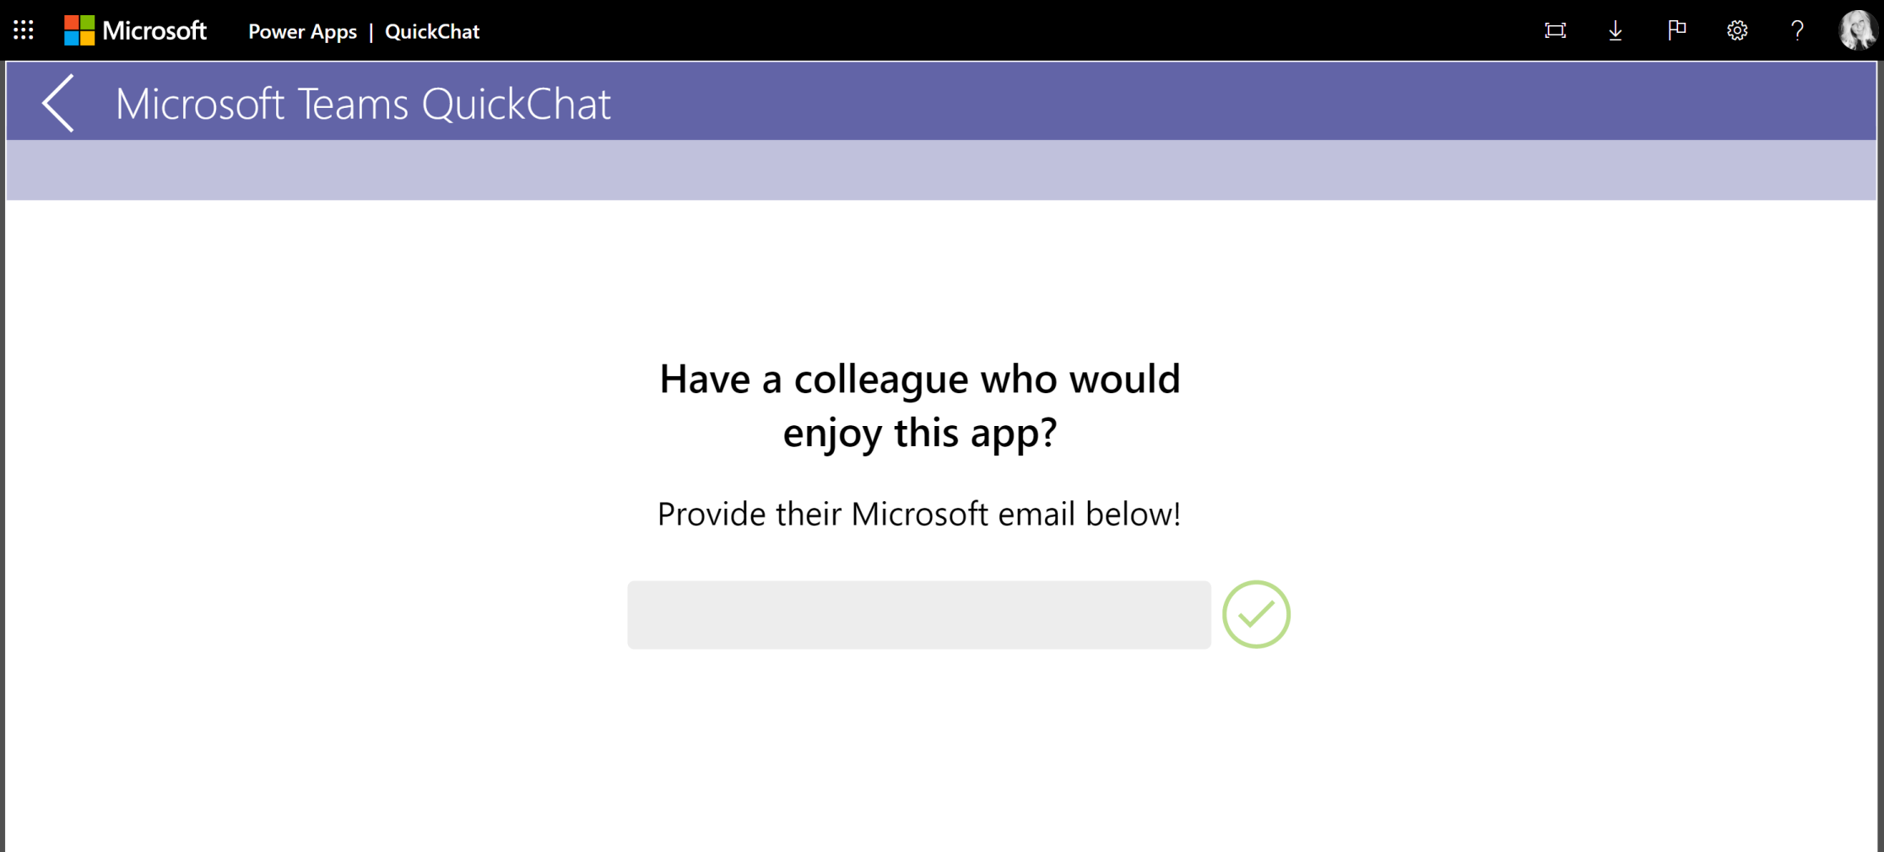
Promoting organic growth through gated user access
A common issue with Power Apps is balancing user access: you want the app to spread organically, but you don't want to use the "Share with everyone" option. So how do you ensure that your app's userbase can grow without you having to manually add users?

Slide 7
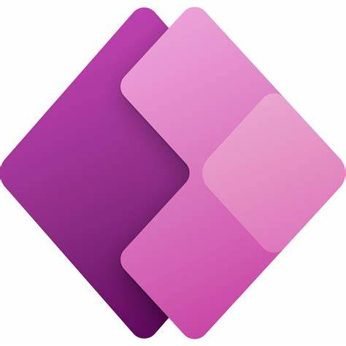
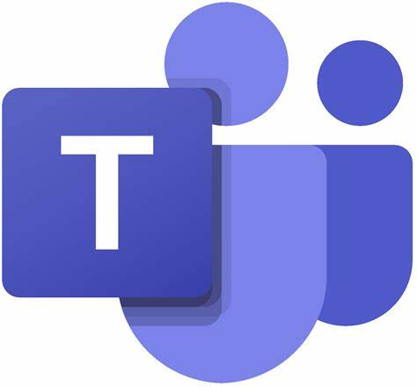

Power Platform + Microsoft Teams
Enhance and augment Teams as a Platform through the Power Platform
Meet the users where they are
Drive new Power Platform interest – imagine if Power Platform usage matched Teams usage
Powered by

Slide 8
Reference materials
Detailed QuickChat LinkedIn article
Download the QuickChat solution from GitHub

